Slide 1
Housing price prediction
Lahari .s.k.
Intern,
flip robo technologies

Slide 2
Contents
1.Problem Definition
2.RoadMap
3.Data Validation
4.Correlation
5.Pre-processing
6.Feature Selection
7.Outliers
8.Splitting data
9.Standard Scaling
10.Model Building

Slide 3
Problem Definition
Houses are one of the necessary need of each and every person around the globe and therefore housing and real estate market is one of the markets which is one of the major contributors in the world’s economy. It is a very large market and there are various companies working in the domain. Data science comes as a very important tool to solve problems in the domain to help the companies increase their overall revenue, profits, improving their marketing strategies and focusing on changing trends in house sales and purchases
Building a model to predict price of houses with the available independent variables. This model is then be used by the management to understand how exactly the prices vary with the variables. Then one can accordingly manipulate the strategy of the firm and concentrate on areas that will yield high returns. Further, the model will be a good way for the management to understand the pricing dynamics of a new market.

Slide 4
Road map
Importing the data
Data Validation
Data Exploration
Data Preprocessing
Feature Engineering
Transformation/Scaling
Model Building
Metrics

Slide 5
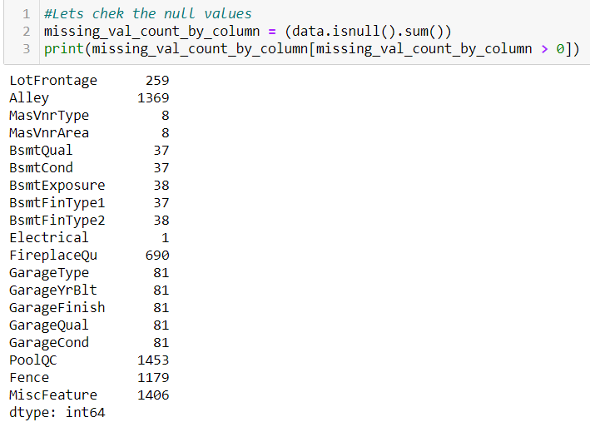
Data Validation
The data set is a comma separated value file. There are two files train and test data.
The test data contains 1168rows and 81 columns whereas the test data has 292 rows and 80 columns.
Below is the attached snapshot of the null values.

Slide 6
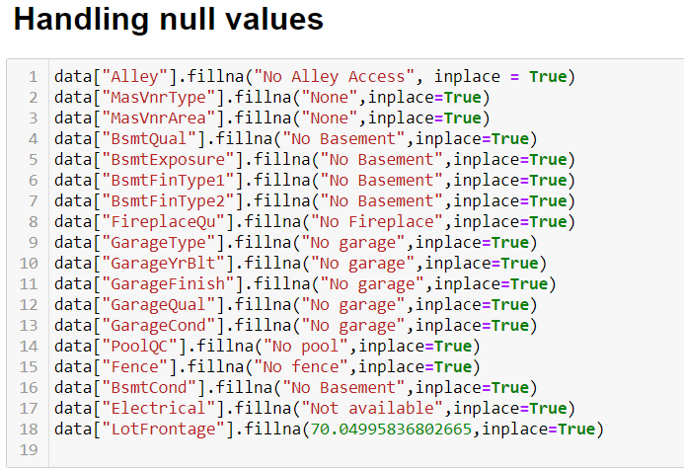
Handling null values

Slide 7
Handling Null values using fillna
Missing values are handled by using fillna. Categorical missing values are handled by filling “Not Available” whereas the numerical missing values is handled by using mean.
Alley,FirePlaceQu,PoolQC,Fence and MiscFeature are dropped because they have many missing values.

Slide 8
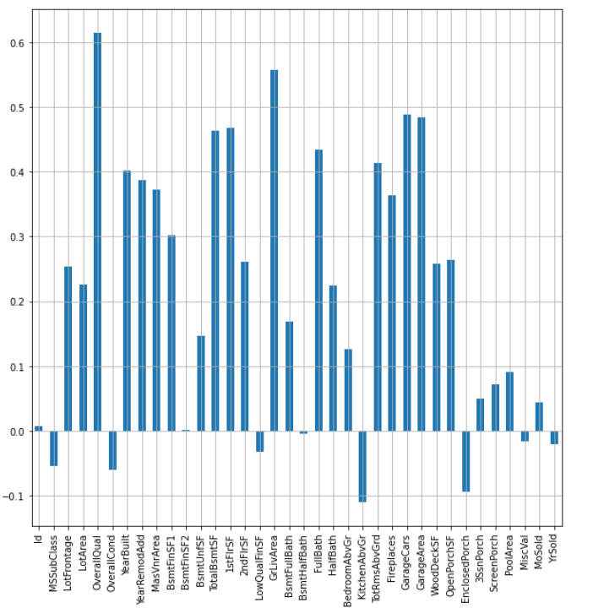
Correlation
LotFrontage,LotArea,OverQuall,YearBuilt,YearReMoadd etc are positively correlated and all the negatively correlated variables are dropped.

Slide 9
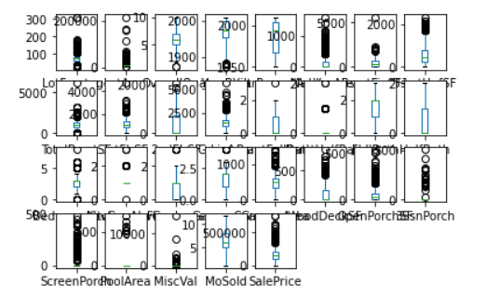
Removal of Outliers
Outliers are removed using quantiles.0.1 and 0.9 quantiles are calculated ,values lesser than 0.1 and greater than 0.9 data points are removed respectively.

Slide 10
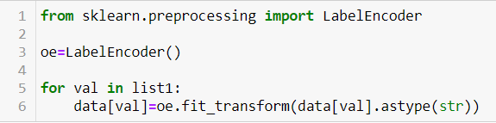
Label Encoder
Label Encoding is used to convert the categorical features into the numeric ones. One of the alternative for the label encoding is get dummies. The decision for choosing label encoder in place of get dummies is that when get dummies is implemented there will be increase in the dimensions. The size is already bit large. It might consume much larger space. Due to space constraint Labelencoder was apt.

Slide 11
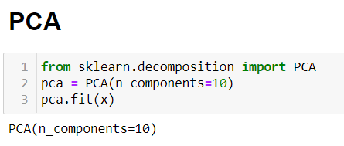
PCA
The most important use of PCA is to represent a multivariate data table as smaller set of variables (summary indices) in order to observe trends, jump clusters and outliers. This overview may uncover the relationships between observations and variables, and among the variables.

Slide 12
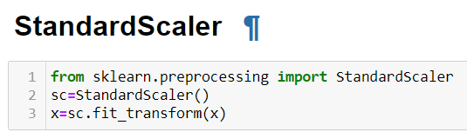
Standard Scalar
Standard scaler is used to scale all values in the same range so that the the graph becomes normalized, mean somewhere lies nearly 0.

Slide 13
Model Building
Algorithms used
1.LinearRegression
2.BayesianRidge
3.Lasso
4.Ridge
5.RandomForestRegressor
6.ExtraTreesRegressor
7.DecisionTreeRegressor

Slide 14
Metrics Calculation

Slide 15
Suitable Metrics
1.R2_Score:
R-squared is a goodness-of-fit measure for linear regression models. This statistic indicates the percentage of the variance in the dependent variable that the independent variables explain collectively. R-squared measures the strength of the relationship between your model and the dependent variable on a convenient 0 – 100% scale.
2. Mean absolute error:
Mean Absolute Error, also known as MAE, is one of the many metrics for summarizing and assessing the quality of a machine learning model. ... Given any test data-set, Mean Absolute Error of your model refers to the mean of the absolute values of each prediction error on all instances of the test data-set.

Slide 16
Suitable Metrics continued
3. Root mean squared error:
RMSE is calculated as the square root of the mean of the squared differences between actual outcomes and predictions.Squaring each error forces the values to be positive, and the square root of the mean squared error returns the error metric back to the original units for comparison.
R2 score is the desirable metric to be considered because rmse can be opted when we are comparing 2 models.R2 score tells us the dependency between dependent and independent variables.

Slide 17
Conclusion
Preference for choosing properties
Residential low density zone, Paved alley access, Regular lot size, near flat or level land contour, all public utilities, inside lot, gentle slope property, single family detached lots, 1 story houses, gable roofstyles,roofs built from Standard Composite shingle, Exterior covering on the house built using vinyl sliding, cider block foundation, gas forced warmair furnace for heating, central air conditioning, standard circuits breakers and romex, attached garages, paved driveway and minimum privacy fence.

Slide 18
Thank You

